Slide 1

Social Media
Report Template
Notes:
Title Slide
Dark

Slide 2

Instructions
Thanks for downloading these templates!
For all marketers, reporting on your monthly metrics is important not only to prove your individual value but also to make future optimization decisions.
This template includes the metrics every social media marketer should report on, including charts and graphs you can edit in Excel with your own data.

Slide 3

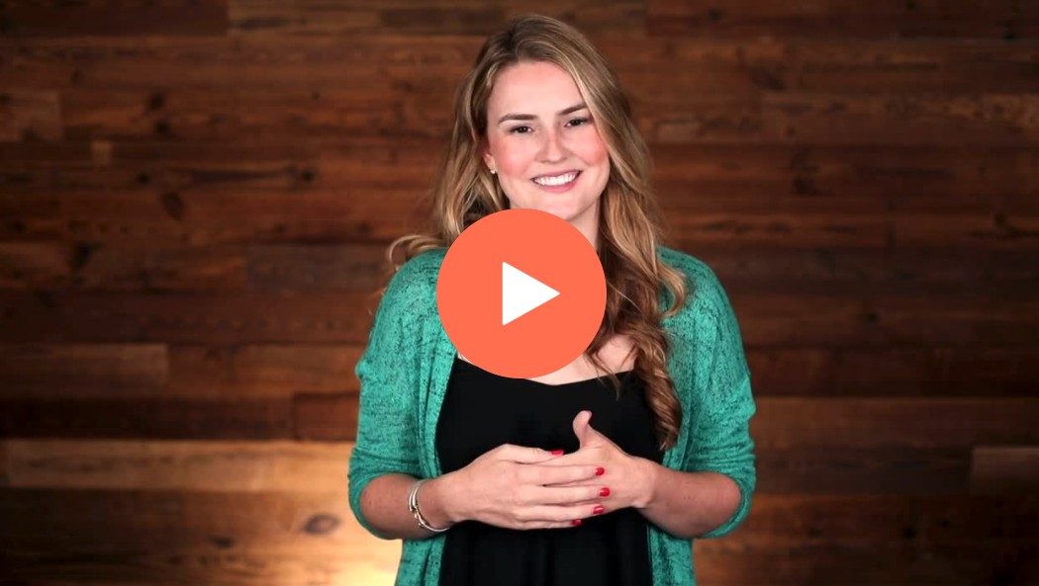
HubSpot Academy
Inbound Certification
Learn how to better position your company with the fundamentals of
Inbound marketing in HubSpot Academy’s free
Inbound Certification Course.
Sign Up Now

Slide 4
Social Media Report Template

Slide 5
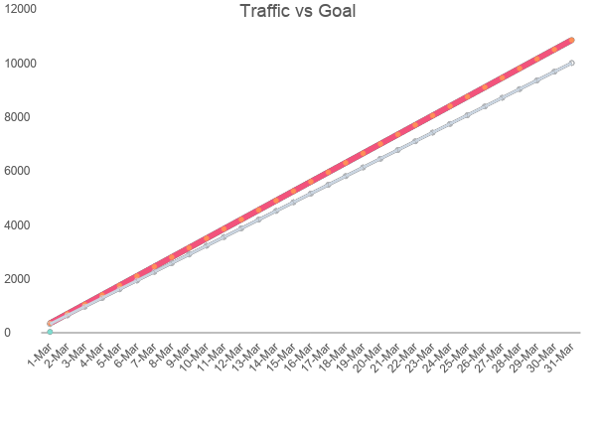
Total Traffic

Slide 6
Total Engagements by Channel
 | Likes | Comment | Shares | All
Facebook | 13000 | 125 | 750
Twitter | 45000 | 45 | 2300
Instagram | 2000 | 75
LinkedIn | 200 | 30 | 45
Totals

Slide 7
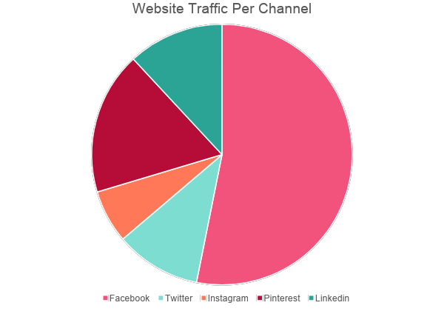
Website Traffic Driven from Social Media Channels

Slide 8
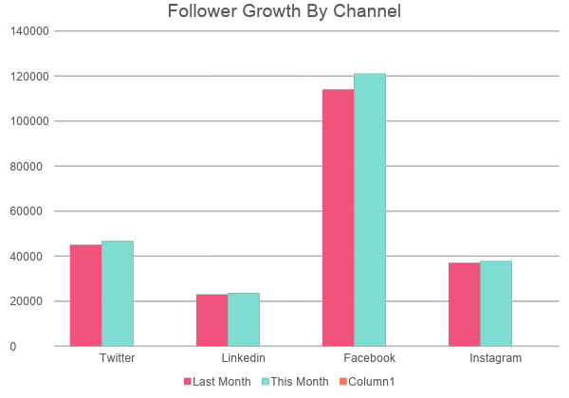
Follower Growth Month over Month

Slide 9
Conversions/
Leads by Channel
 | Clicks | Conversions | Conversion Rate
Facebook | 2000 | 980
Twitter | 30000 | 1222
Instagram | 35 | 11
LinkedIn | 65 | 27
Totals

Slide 10
Top 3 Social Posts - Facebook
Post 1
Post 2
Post 3
Insert Imagery Here

Slide 11
Top 3 Social Posts - Twitter
Post 1
Post 2
Post 3
Insert Imagery Here

Slide 12
Top 3 Social Posts - Instagram
Post 1
Post 2
Post 3
Insert Imagery Here

Slide 13
Top 3 Social Posts - LinkedIn
Post 1
Post 2
Post 3
Insert Imagery Here

Slide 14
Top 3 Landing Pages from Social
Landing Page 1
Landing Page 2
Landing Page 3
Insert Imagery Here

